Slide 1

Breaking Barriers: Addressing Preceptor Challenges in Nurse Practitioner Education for Primary Care Solutions
Jay Prosser, DNP, RN, CCRN-K, NE-BC
June 17 – 19, 2024

Slide 2
No Disclosures or Conflicts of Interest

Slide 3

About Me

Slide 4
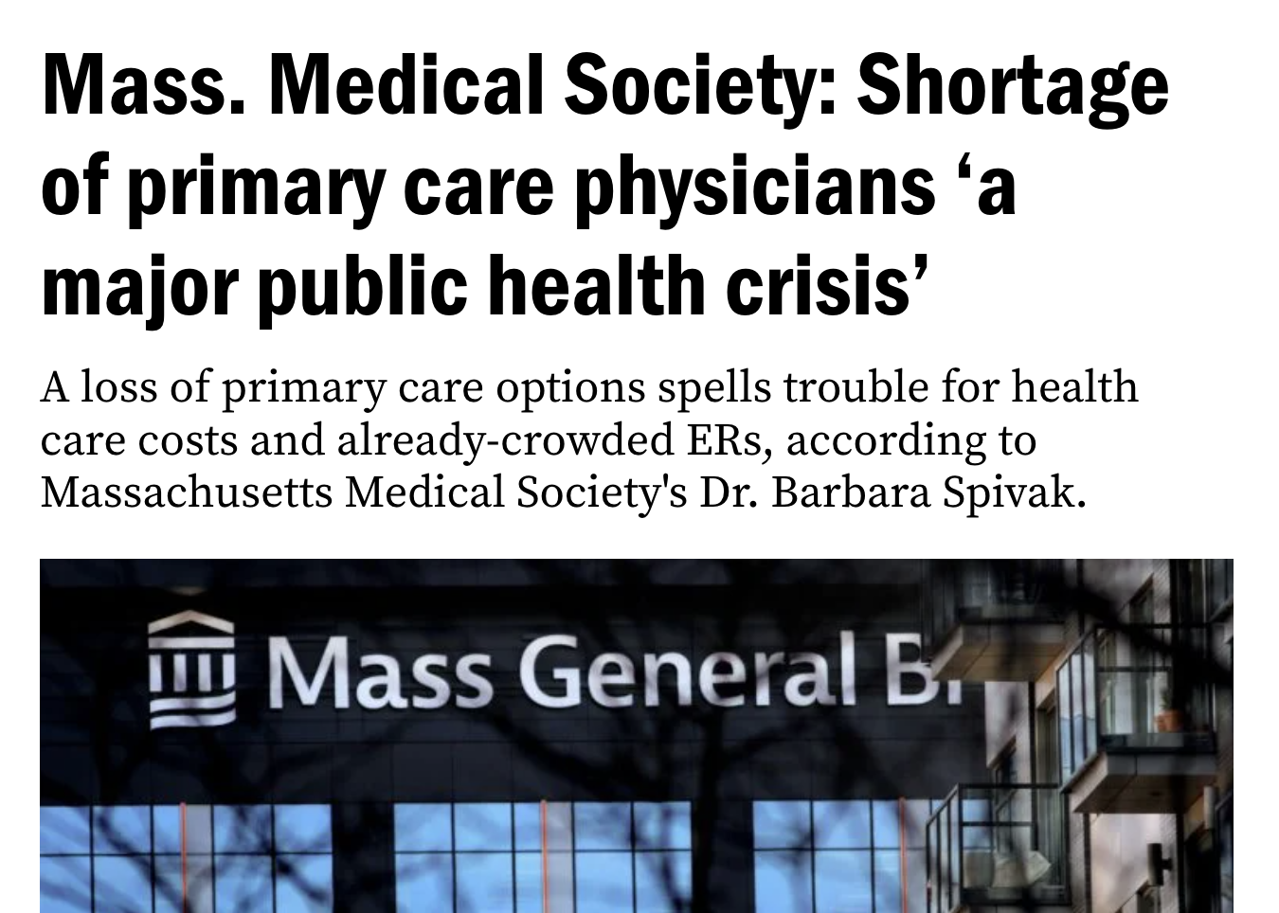
How Did We Get Here?

Slide 5
What Does the Primary Care Crisis Look like in Massachusetts?
In 2020, Massachusetts lost 3.6% of the primary care physician workforce, compared to 3.3% nationally.
More than 33% of primary care physicians in Massachusetts are over the age of 60.
One-third of Massachusetts residents report having no primary care physician due to lack of availability.

Slide 6
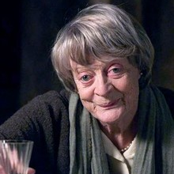
A Patient’s Perspective
81-year-old female
Post acute myocardial infarction
Has no PCP
Currently on 12-month waiting list

Slide 7

The State of Medical Schools and Primary Care
Of all current medical school students in Massachusetts, only 23.6% of them plan to become primary care physicians.

Slide 8
What happens when there are no PCPs?
Population health declines
Screenings go down
No preventative care
Emergency Departments become default PCP offices
Perpetuates disparities
Preventive care: 81% of whites; 64% of Hispanics
Community disparities
Overcrowding

Slide 9
The nurse practitioner field
Demand is projected to grow by 28% overall.
Massachusetts’ projected growth is 16%.
New York’s projected growth is 41%.
The number of NP graduates each year has risen anywhere from 6.5% to 14.2% each year since 2015.

Slide 10
Nurse Practitioners as
Primary Care Providers
70% of practicing NPs deliver primary care.
88% of NPs are educated and prepared in primary care delivery.

Slide 11
Nurses could help solve this problem!
Full practice authority in Massachusetts.
The quality of care provided by nurse practitioners is equal to or better than that provided by primary care physicians.

Slide 12
Roadblock!
Nothing in healthcare is that easy

Slide 13
Nurse Practitioner Education
The clinical component to NP education is paramount.
Massachusetts preceptor hours have ranged from 500-665. The new standards is 750 clinical hours.

Slide 14
Preceptor Challenge
Without preceptors, students cannot complete their education.

Slide 15

High Demand = Opportunity

Slide 16
The Gentleman’s Agreement
The traditional view of precepting.
”We do not pay preceptors.”

Slide 17
The Black Market
Not addressing a problem always creates a black market which offers solutions as a high cost.
Demand for payment.
Soliciting students for payment.

Slide 18
Potential Solutions

Slide 19
Pay Preceptors
Physician assistant programs pay preceptors.
Should we match this?
If each state sets standards, then we decrease the influence of black markets.

Slide 20
Challenges to Paying Preceptors
Who pays for this?
Schools do not have budgets.
The cost is passed on to students.
Are preceptors contract staff or are they issued 10-99?
Does this create a different predatory pathway?
Does this set a precedent that we do not get back from?

Slide 21
Tax Credit
Current program in other states with a credit ranging from $1,000 per calendar year to a high of $10,000 per calendar year.
$2,150 for a full clinical rotation with a maximum of $8,600 per calendar year.

Slide 22
Paying Institutions
Hypothesis: If providers are paid off of productivity and precepting limits productivity then reimbursements are in turn negatively affected.
Preceptor survey: protected time with students.
Clinical reimbursement for precepting.
Higher rate for clinics?
State-awarded stipend?
Block grant?

Slide 23
Health Care Organizations &
Academic Institutions
Setting: Hospital systems with clinics
NP clinical instructor works for the clinic and is paid by the clinic
NP clinical instructor precepts the student

Slide 24
Preceptor Structure Re-evaluation
NP preceptor ratio is 1:1
Medical student ratio can be 1:3
Should we re-evaluate?

Slide 25
More Challenging Questions

Slide 26
Matching?
Should the entire structure of how nurse practitioner students are placed in clinical change?
Is it time to consider a matching process similar to what is done with medical students?

Slide 27
GME Funding
Graduate medical education is funded primary by Medicare
Medicare has funded GME since 1955
Should there be a platform for more equity between GME and NP training?

Slide 28
Limiting Admission Capabilities
If programs could guarantee preceptor slots, they could admit more students.

Slide 29
We Must Address This
If we fail to address this formally and enact systems, we will create further inequities and ultimately fail our students and the healthcare system.

Slide 30

Questions & Discussion

Slide 31
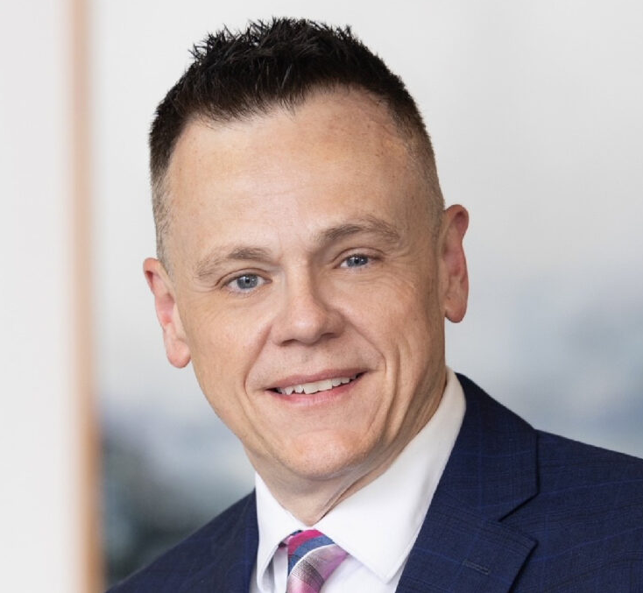
Contact Information
Jay Prosser DNP, RN, CCRN-K, NE-BC
Executive Director, Nursing Council on Workforce Sustainability
  Jay.Prosser@umassmed.edu
      774.622.1356

Slide 32
Thank You

